Slide 1
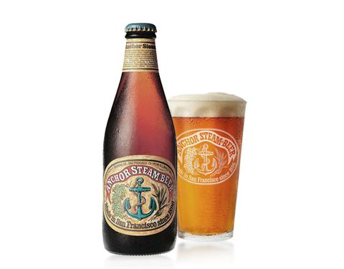
Microbrewery growth in Illinois, Wisconsin, Michigan & Colorado
Mark Green Stephanie Armenta Richard Robinson

Slide 2
PROJECT TITLE: Growth of Microbrewery in Illinois, Colorado, Michigan and Wisconsin
TEAM: Mark Green, Stephanie Armenta, Richard Robinson
DESCRIPTION: Our mission is to establish the current density of Microbrewery in targeted states by count and location in efforts to identify new growth and/or entrepreneurial opportunities.
DATA: Microbrewery data from Kaggle with over 7000 data sets.
QUESTIONS: Where are the locations? What are the hours of operation? Which state has the most microbrewery? Where are the opportunities?
PRODUCTION TOOLS: Tableau, Machine Learning, Python Panda, Power Point, Plotly, MongDB
BACKGROUND:
A microbrewery or craft brewery is a brewery that produces small amounts of beer, typically much smaller than large-scale corporate breweries, and is independently owned. Such breweries are generally characterized by their emphasis on quality, flavor and brewing technique.

Slide 3
PANDAS PYTHON

Slide 4
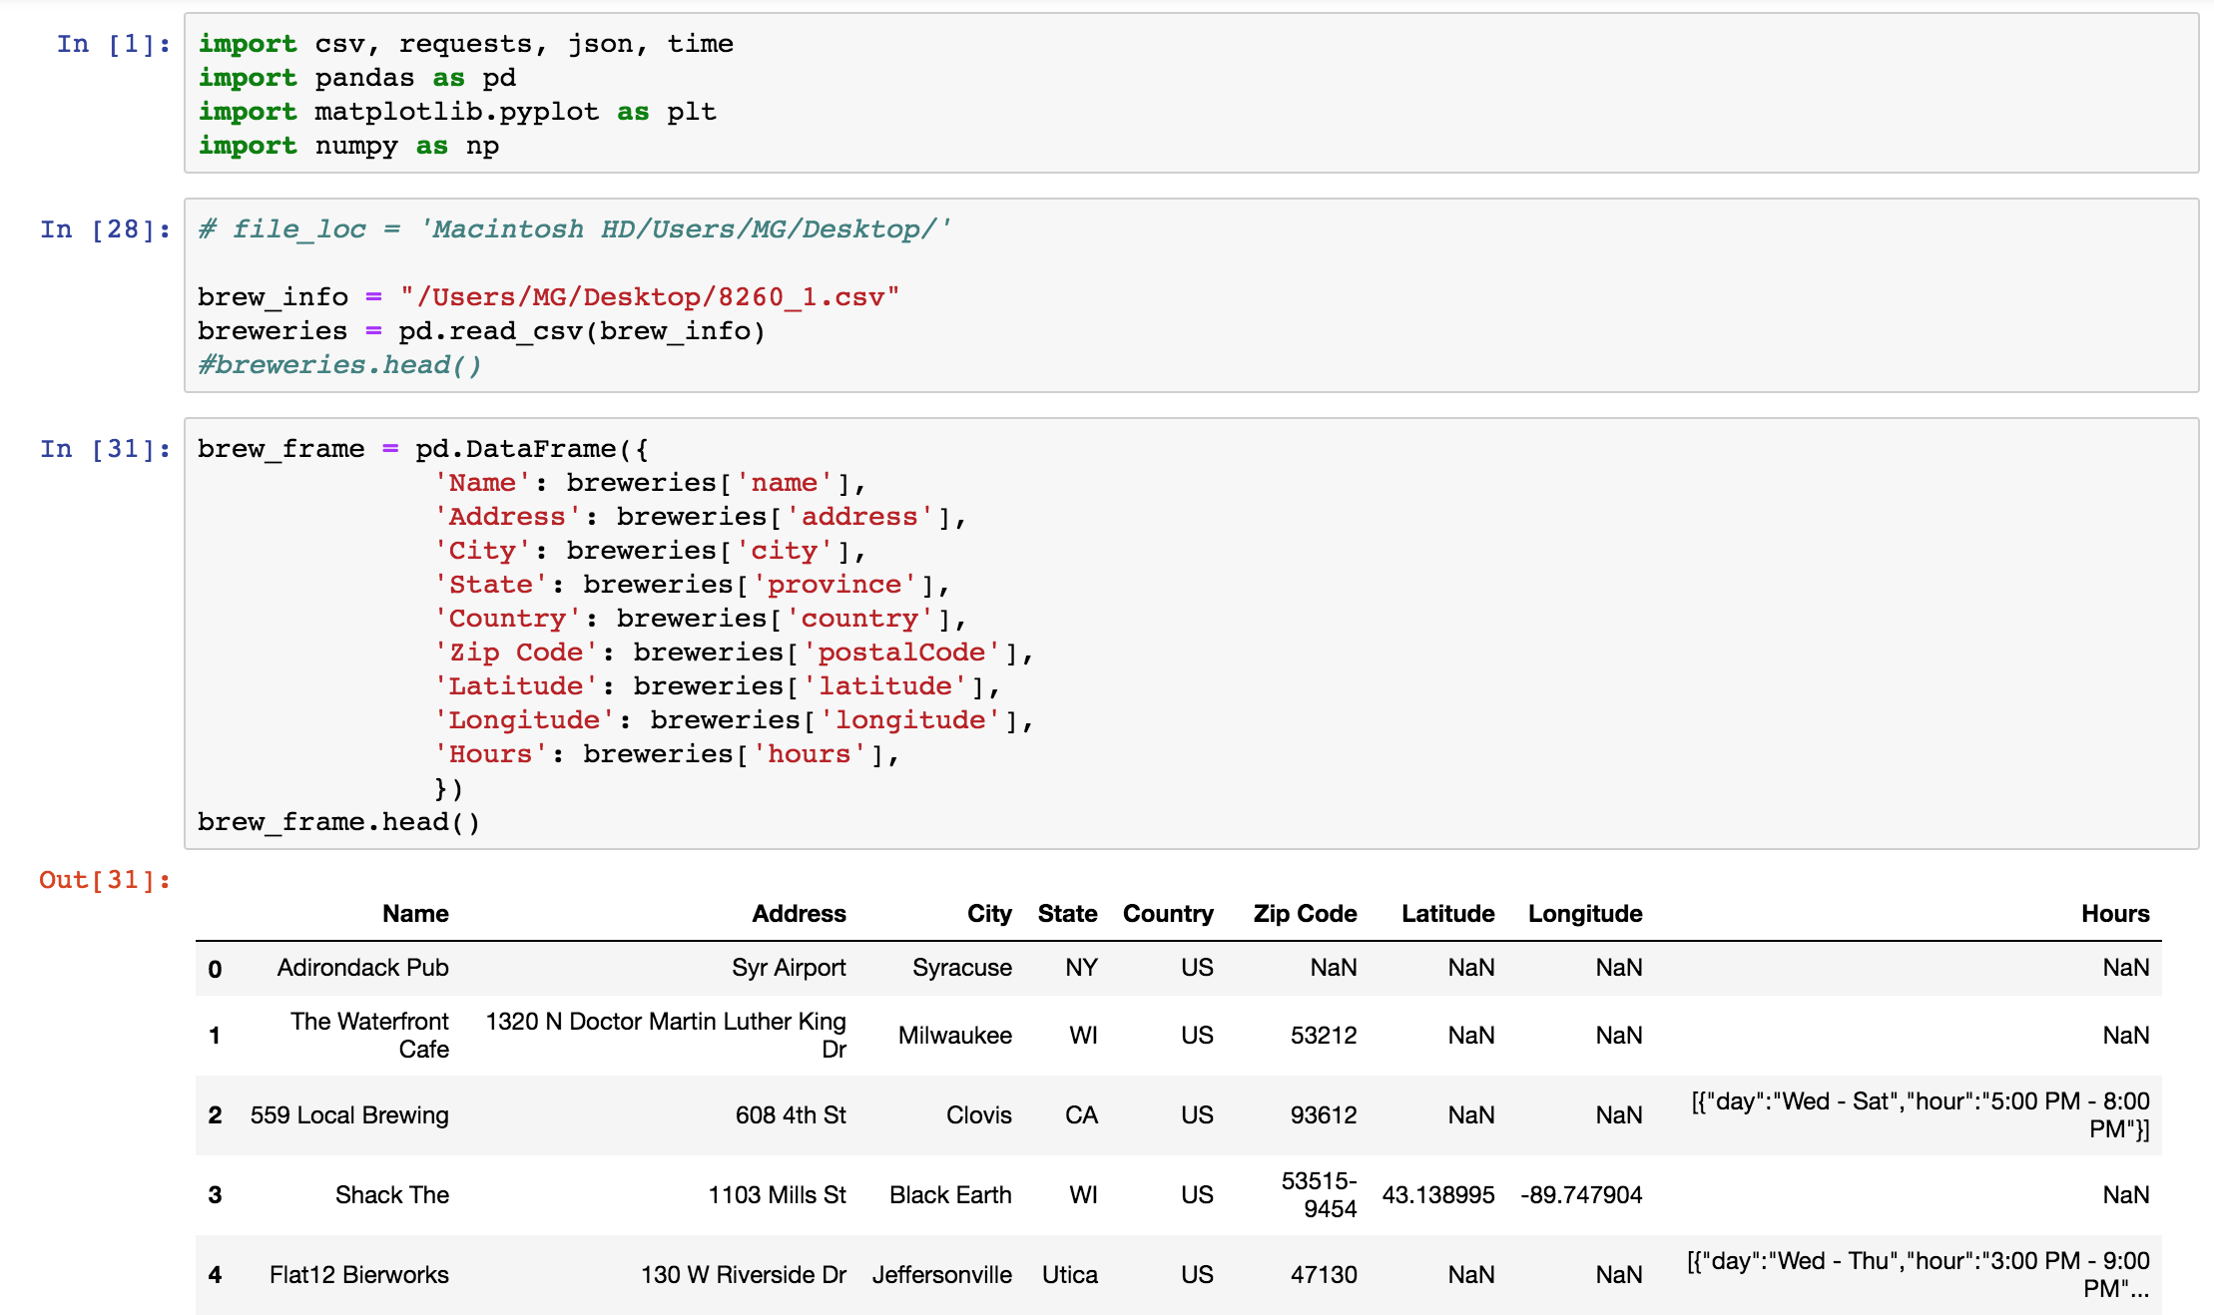

Slide 5
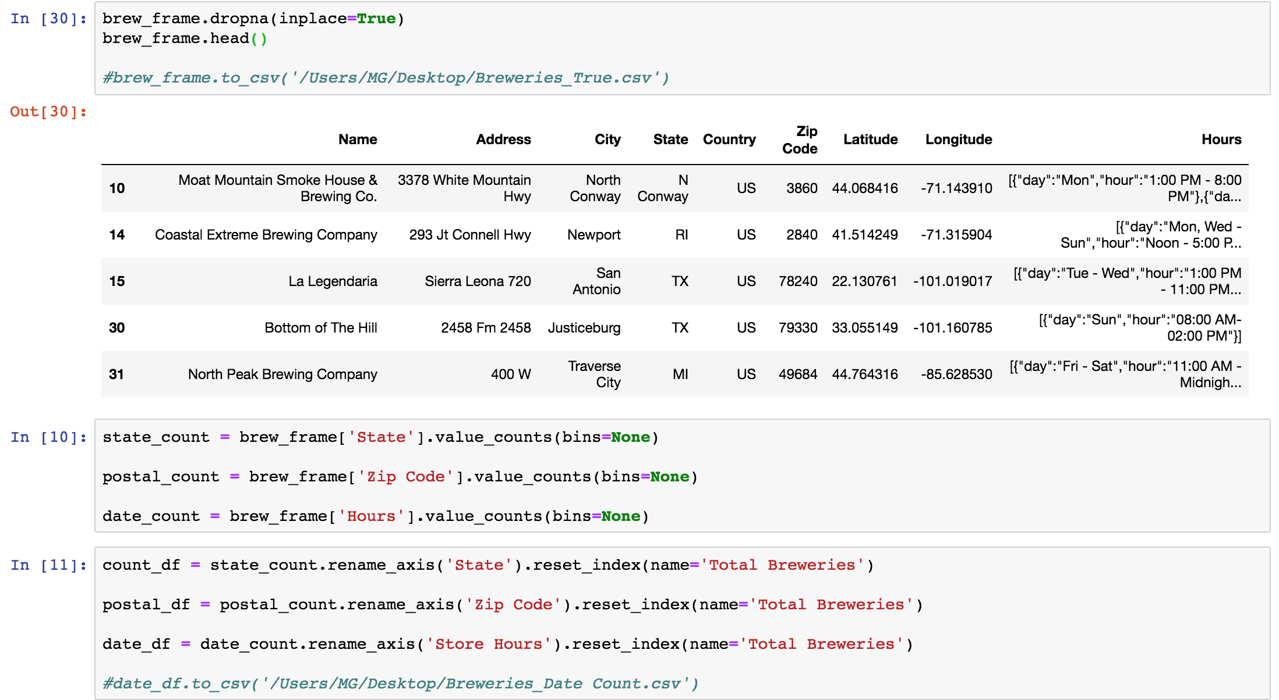

Slide 6
MongoDB

Slide 7
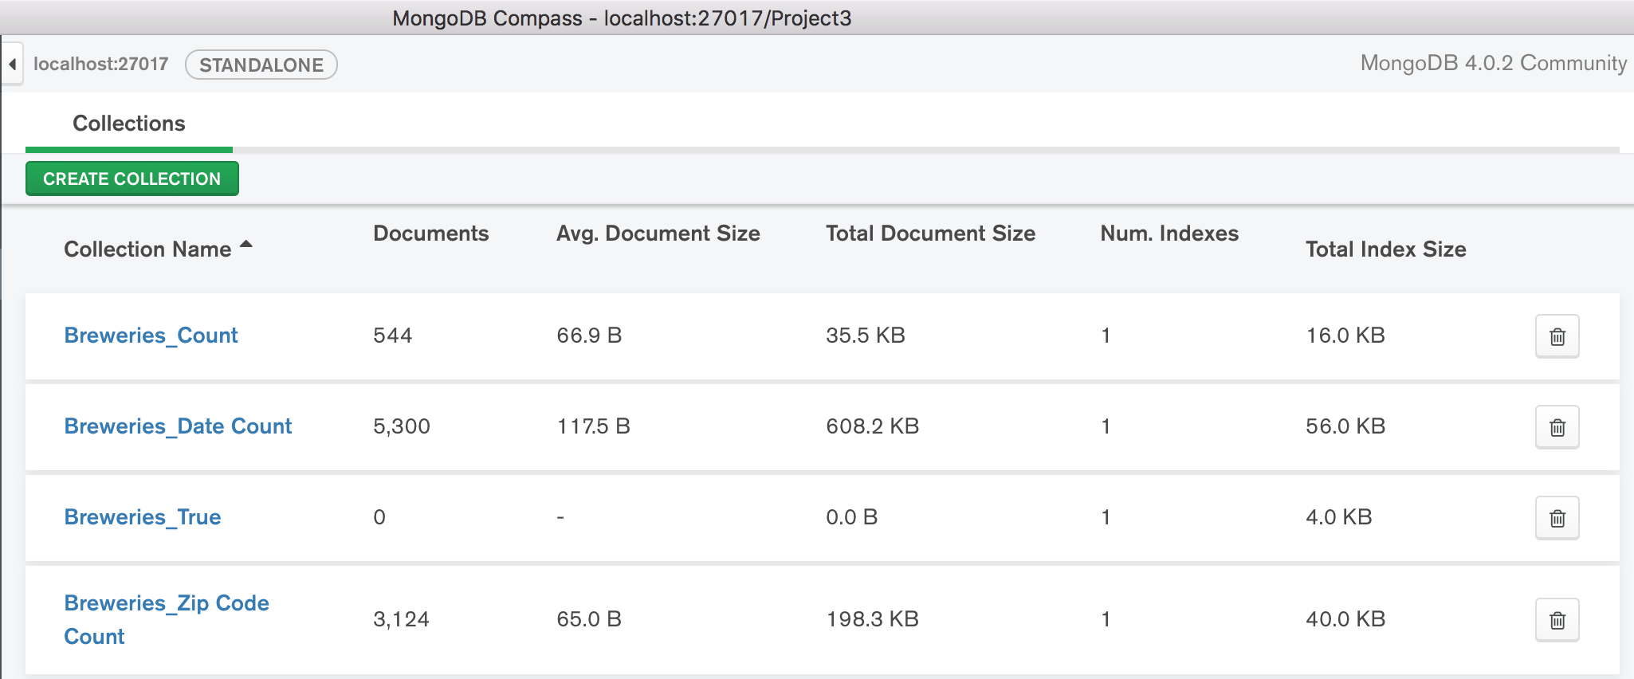

Slide 8
Database - Project 3
Collections – 4
Breweries_Count
Breweries_Date Count
Breweries_Zip Code Counts
Breweries_True
used collection above to export
4 Breweries csv’s
Breweries_IL
Breweries_CO
Breweries_MI
Breweries_WI

Slide 9
Plotly

Slide 10
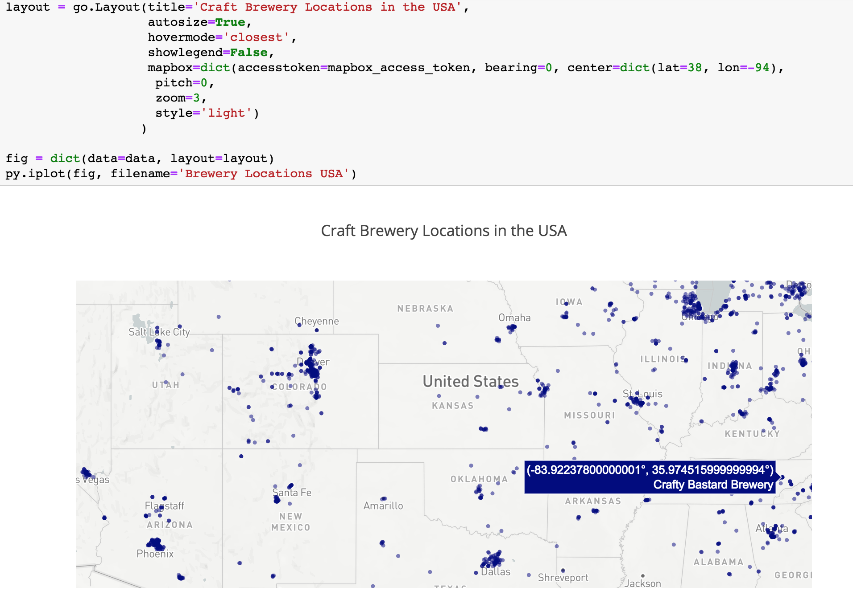

Slide 11
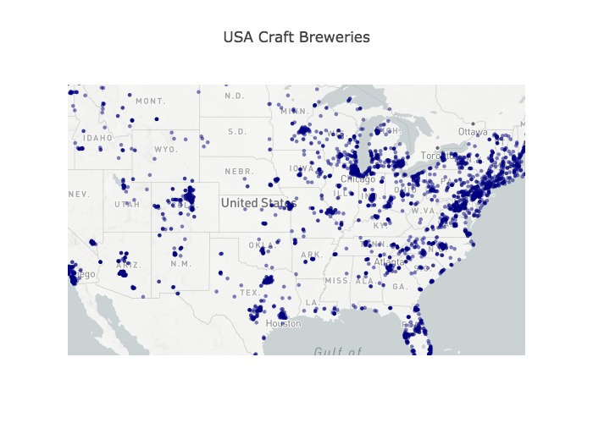

Slide 12
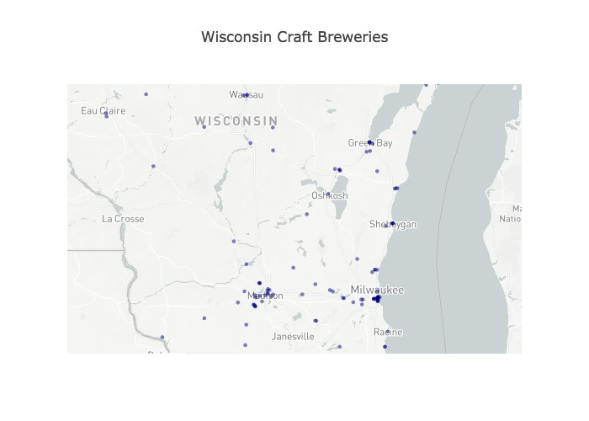

Slide 13
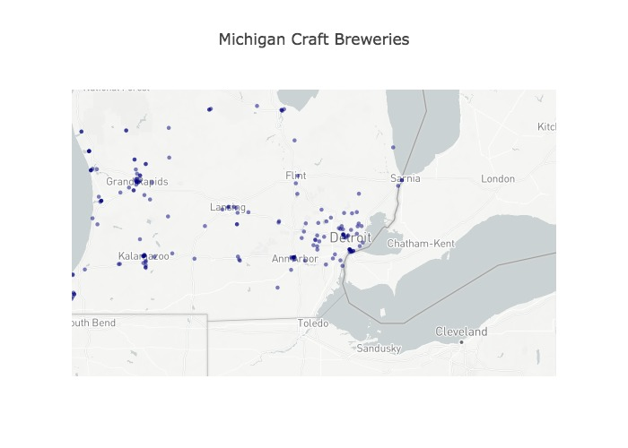

Slide 14
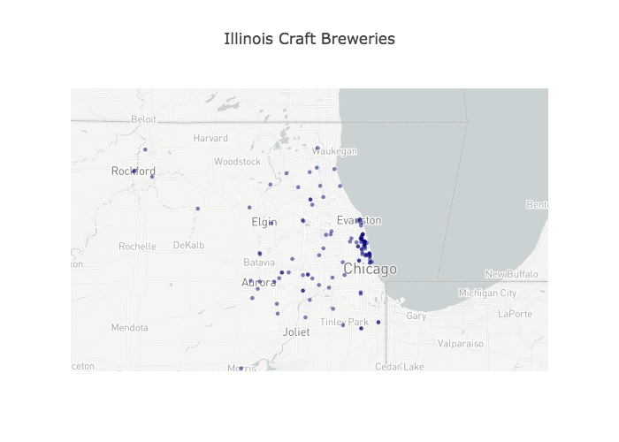

Slide 15
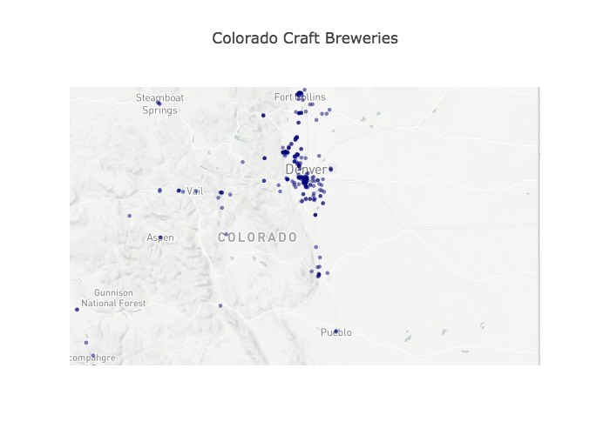

Slide 16
Machine Learning
Regression

Slide 17
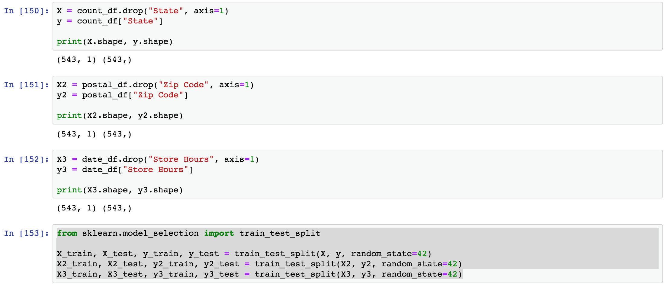

Slide 18
Machine Learning
Random Forest/KNN

Slide 19
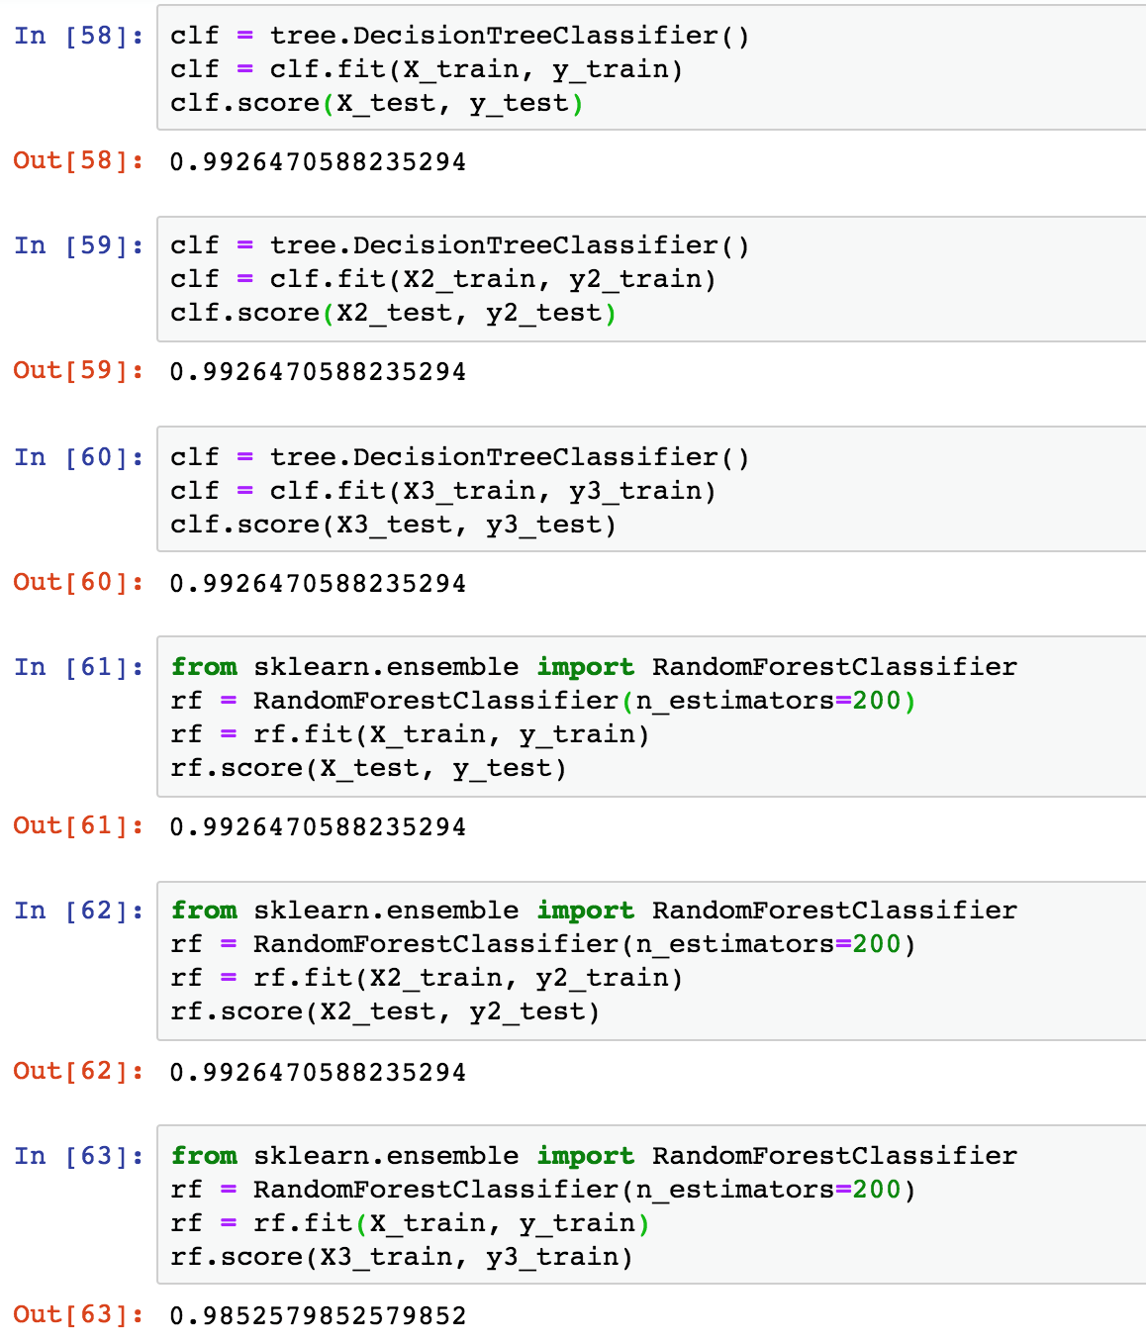

Slide 20
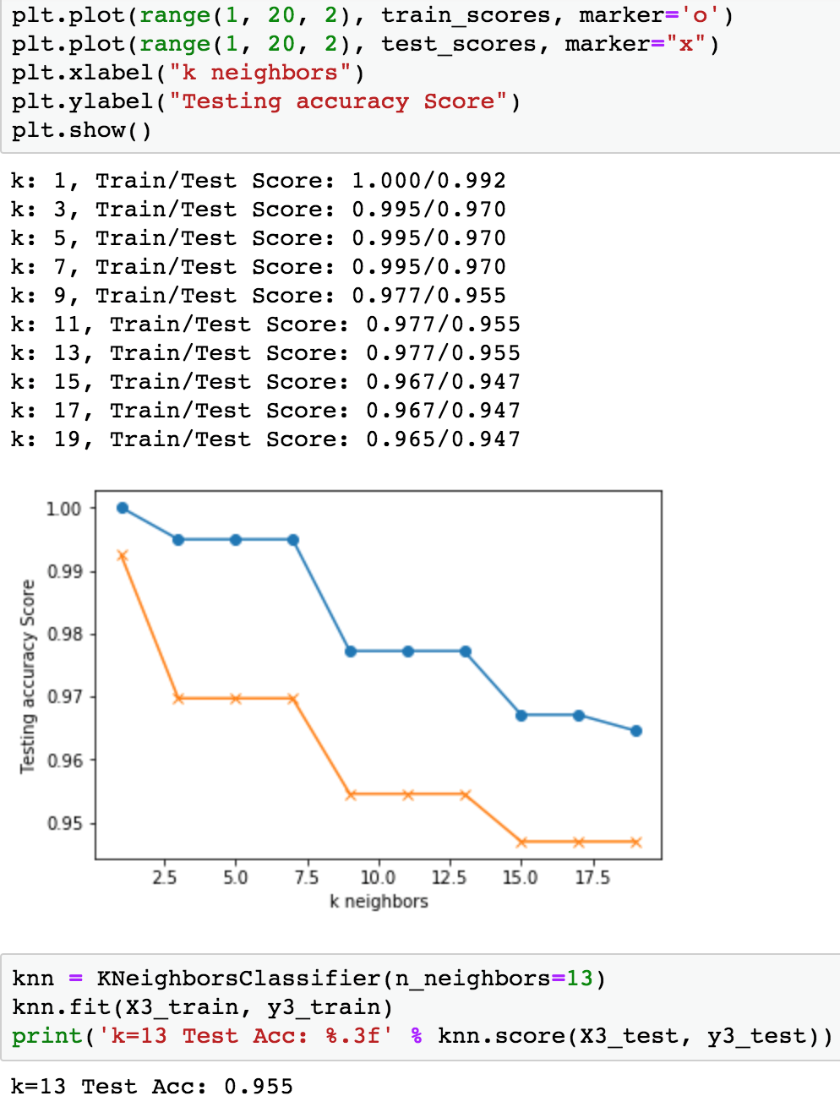

Slide 21
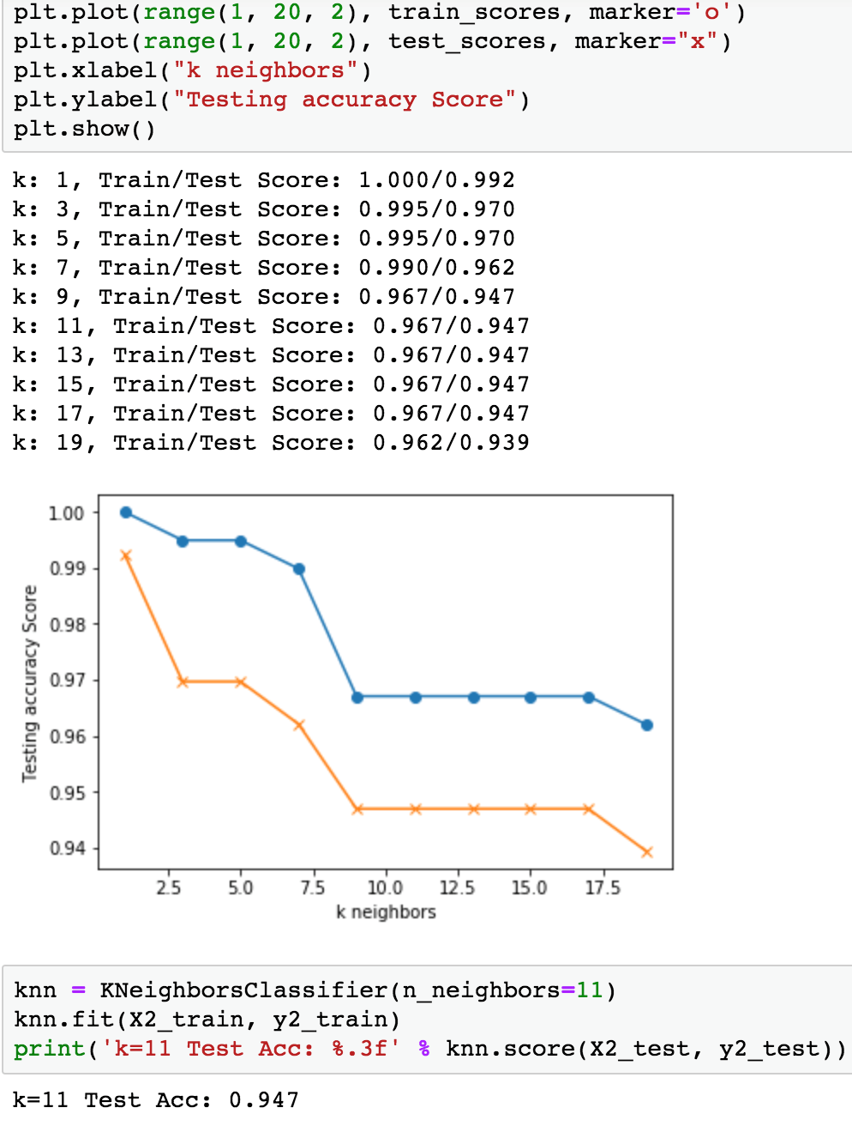

Slide 23
FACTOID:
The first brewery in the United States was opened by David G. Yuengling & Sons in Pottsville, Pa., in 1829 and is still owned and operated by the family. Based on volume sold in 2016 it was the top craft beer in the US.
Founded in 1965 (practically prehistoric by craft standards), Anchor is the first modern craft brewery, Acitelli says. Its signature offering—Anchor Steam Beer—is one of only three beer styles (steam, cream ale, and light beer) native to America,
Between 2012 and 2016 (County Business Patterns) the total number of breweries skyrocketed from 800 to 2,802. These small businesses employed over 55,000 workers with a total annual payroll of $2.6 billion.
Every one of the 50 states and just over a quarter of the nation’s 3,143 counties have a least one brewery
In 2016, the states with the highest of breweries were: California (368), Colorado (204), Washington (162), New York (152), and North Carolina (129) (In 2016, Illinois had a total of 88)

Slide 24
Data Shortcomings:
Ability to discern whether each location was a stand alone Microbrewery or combination restaurant.
Ascertaining production by volume of each entity to compare size.
Ascertaining amount of startup capital or what the true cost are.
Barriers to entry.

Slide 25
Questions & Answers

